Slide 1
T1D Beta diversity update
Jochum, Michael D.
9 August 2022

Slide 2
Objective : Rerun the beta diversity analyses using phylogenetic distances instead of just bray-curtis
Analysis Steps:
Make a phylogenetic distance tree of the taxa
Analyze dissimilarity using phylogenetic distance via:
Weighted UNIFRAC
Unweighted UNIFRAC
Run adonis permutational ANOVA
Especially look for significance across neonatal samples Ear and Stool by:
Disease
Delivery mode
Maternal 1st Trimester HbA1C values
impute NA values for T1d patients based on knn algo
Generate a norm distribution of healthy 1st Trimester HbA1C values for the Control patients
Make new dimensional reduction PCoA figures using the Unifrac distance scores
Annotate figured with the adonis permanova pvalue scores
Update 9 august 2022

Slide 3
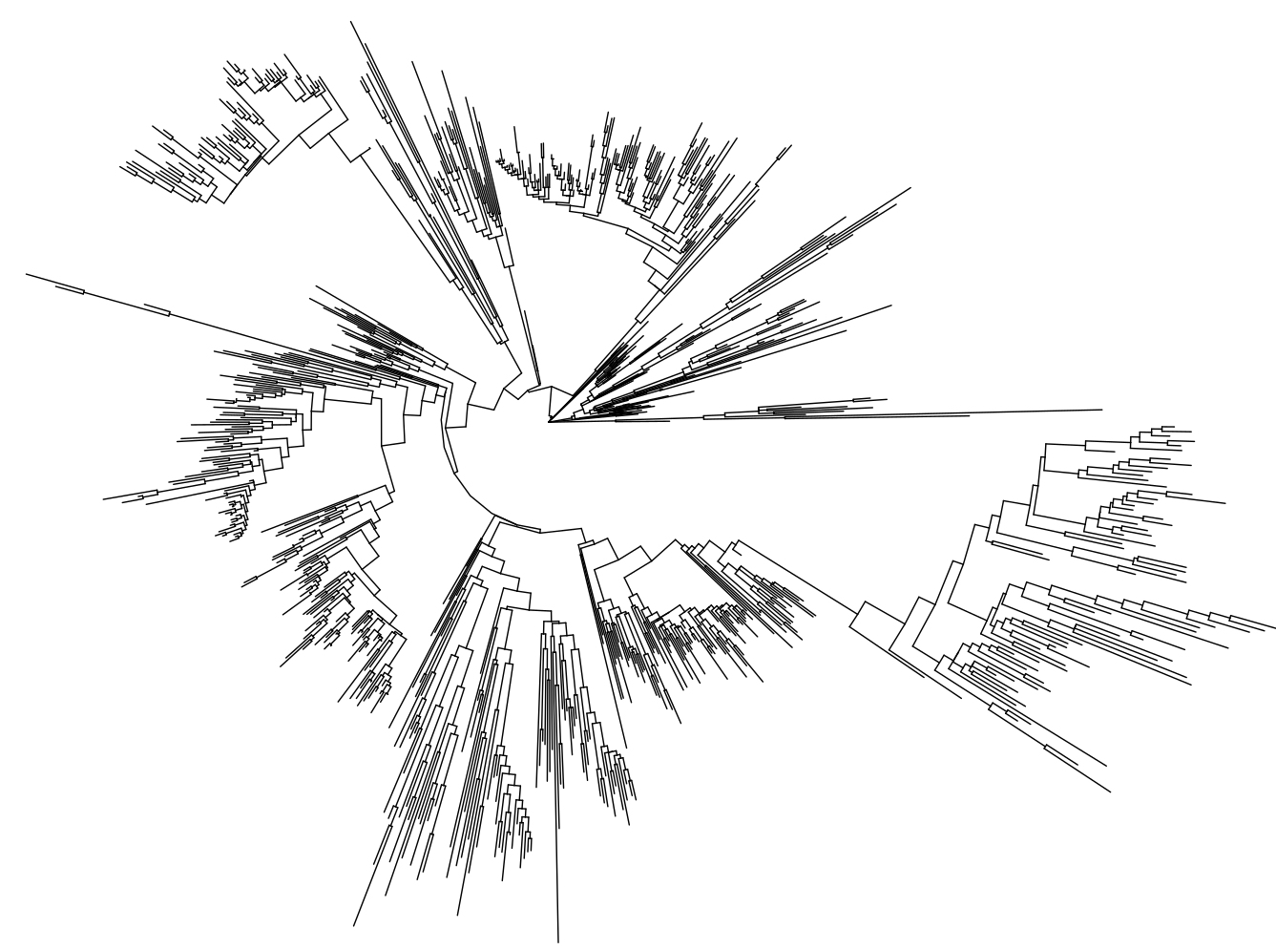
Make a phylogenetic distance tree of the taxa
overview of phylogenetic distances for all samples based on ASV fasta sequence alignment optimal model fit
2683 tips and 2681 internal nodes

Slide 4
Analyze dissimilarity using phylogenetic distance
 |  |  | Weighted UniFrac |  |  |  |  | Unweighted UniFrac
Host | Sample Type | Variable | SumOfSqs | R2 | statistic | p.value |  | SumOfSqs | R2 | statistic | p.value
Maternal | Anus | Type 1 Diabetes | 0.01 | 0.03 | 2.57 | 0.0406 | * | 0.72 | 0.02 | 1.84 | 0.0034 | **
 |  | Delivery Mode | 0.00 | 0.01 | 0.51 | 0.7685 |  | 0.46 | 0.01 | 1.15 | 0.1833
 |  | 1st Tri HbA1C | 0.00 | 0.01 | 0.97 | 0.3855 |  | 0.59 | 0.02 | 1.49 | 0.0216 | *
 | Cervix | Type 1 Diabetes | 0.00 | 0.01 | 0.78 | 0.5825 |  | 0.52 | 0.01 | 1.17 | 0.2411
 |  | Delivery Mode | 0.00 | 0.01 | 1.03 | 0.3906 |  | 0.38 | 0.01 | 0.85 | 0.6525
 |  | 1st Tri HbA1C | 0.00 | 0.01 | 0.79 | 0.556 |  | 0.38 | 0.01 | 0.87 | 0.6371
 | Introitus | Type 1 Diabetes | 0.00 | 0.02 | 1.44 | 0.1824 |  | 0.60 | 0.01 | 1.32 | 0.0746
 |  | Delivery Mode | 0.00 | 0.02 | 1.67 | 0.112 |  | 0.61 | 0.02 | 1.36 | 0.0611
 |  | 1st Tri HbA1C | 0.00 | 0.02 | 1.75 | 0.0946 |  | 0.54 | 0.01 | 1.19 | 0.1703
 | Vagina | Type 1 Diabetes | 0.00 | 0.01 | 1.14 | 0.3226 |  | 0.58 | 0.01 | 1.31 | 0.1028
 |  | Delivery Mode | 0.00 | 0.02 | 1.73 | 0.1034 |  | 0.47 | 0.01 | 1.06 | 0.3484
 |  | 1st Tri HbA1C | 0.00 | 0.00 | 0.45 | 0.8508 |  | 0.57 | 0.01 | 1.27 | 0.1299
Neonatal | Ear | Type 1 Diabetes | 0.01 | 0.02 | 1.76 | 0.0831 |  | 0.53 | 0.01 | 1.23 | 0.0954
 |  | Delivery Mode | 0.01 | 0.02 | 2.00 | 0.0508 | * | 0.74 | 0.02 | 1.72 | 0.0027 | **
 |  | 1st Tri HbA1C | 0.01 | 0.04 | 3.20 | 0.0076 | ** | 0.57 | 0.02 | 1.31 | 0.0567
 | Stool | Type 1 Diabetes | 0.00 | 0.03 | 2.27 | 0.0544 | * | 0.99 | 0.03 | 2.30 | 0.0034 | **
 |  | Delivery Mode | 0.00 | 0.10 | 8.16 | 0.0001 | **** | 2.15 | 0.07 | 5.16 | 0.0001 | ****
 |  | 1st Tri HbA1C | 0.00 | 0.01 | 0.63 | 0.6338 |  | 0.36 | 0.01 | 0.81 | 0.7286

Slide 5
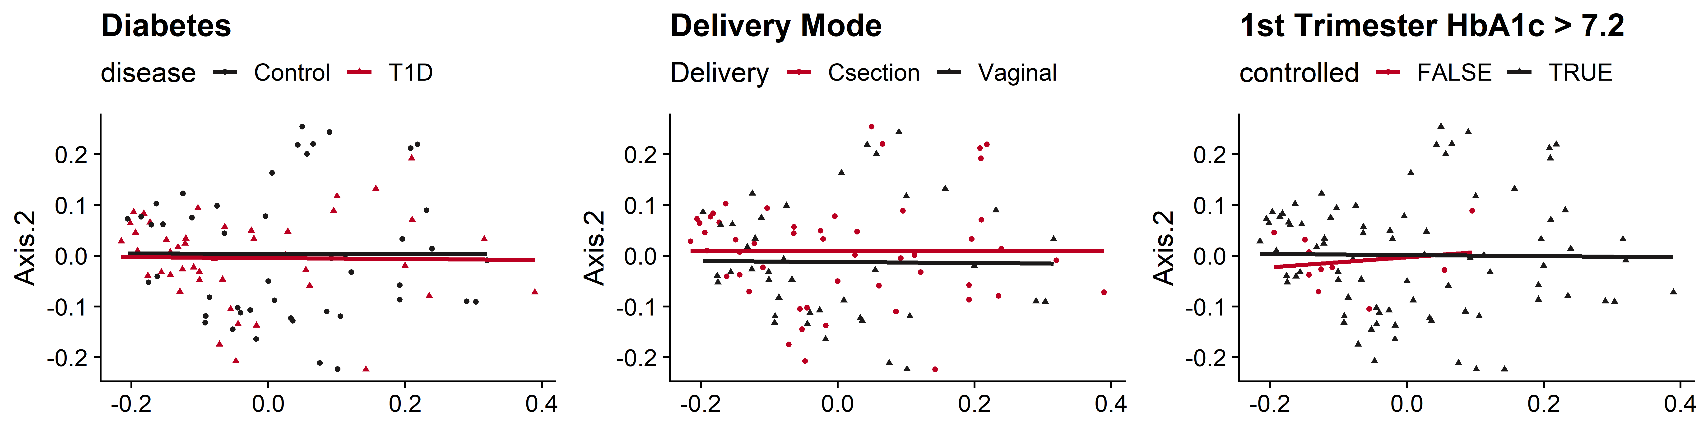
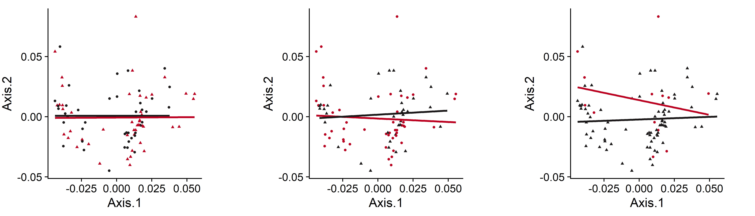
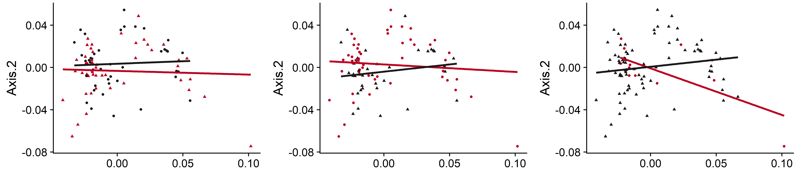
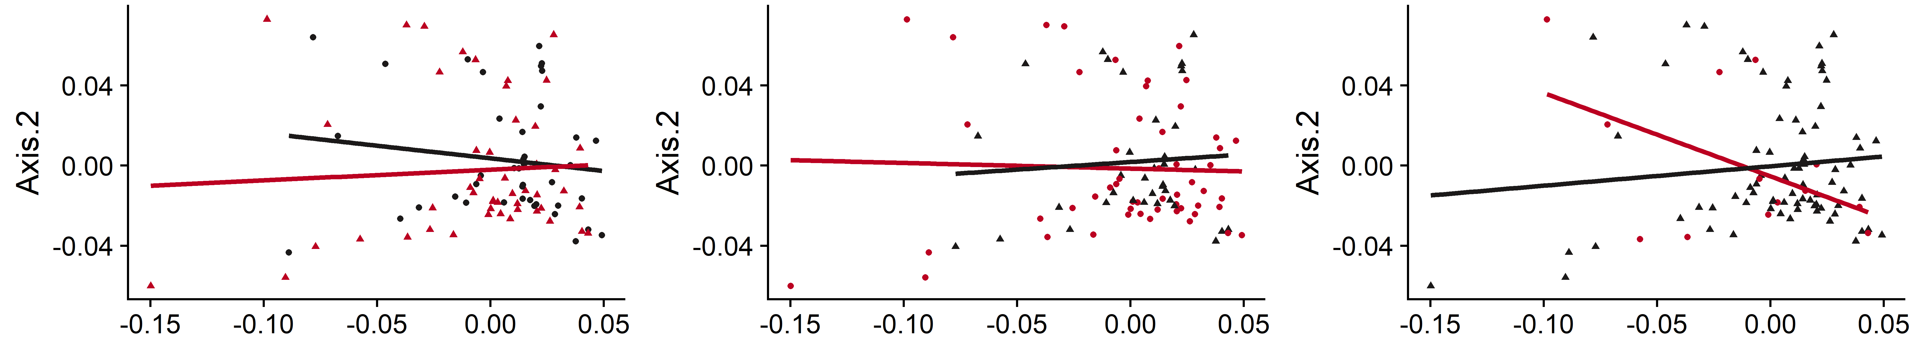
Weighted UniFrac
Rectum
 |  | Weighted UniFrac
Sample Type | Variable | SumOfSqs | R2 | statistic | p.value
Rectum | Type 1 Diabetes | 0.01 | 0.03 | 2.57 | 0.0406 | *
 | Delivery Mode | 0.00 | 0.01 | 0.51 | 0.7685
 | 1st Tri HbA1C | 0.00 | 0.01 | 0.97 | 0.3855
Cervix | Type 1 Diabetes | 0.00 | 0.01 | 0.78 | 0.5825
 | Delivery Mode | 0.00 | 0.01 | 1.03 | 0.3906
 | 1st Tri HbA1C | 0.00 | 0.01 | 0.79 | 0.556
Introitus | Type 1 Diabetes | 0.00 | 0.02 | 1.44 | 0.1824
 | Delivery Mode | 0.00 | 0.02 | 1.67 | 0.112
 | 1st Tri HbA1C | 0.00 | 0.02 | 1.75 | 0.0946
Vagina | Type 1 Diabetes | 0.00 | 0.01 | 1.14 | 0.3226
 | Delivery Mode | 0.00 | 0.02 | 1.73 | 0.1034
 | 1st Tri HbA1C | 0.00 | 0.00 | 0.45 | 0.8508
PERMANOVA = 0.0406 *
Cervix
MidVaginal
Vaginal Introitus

Slide 6
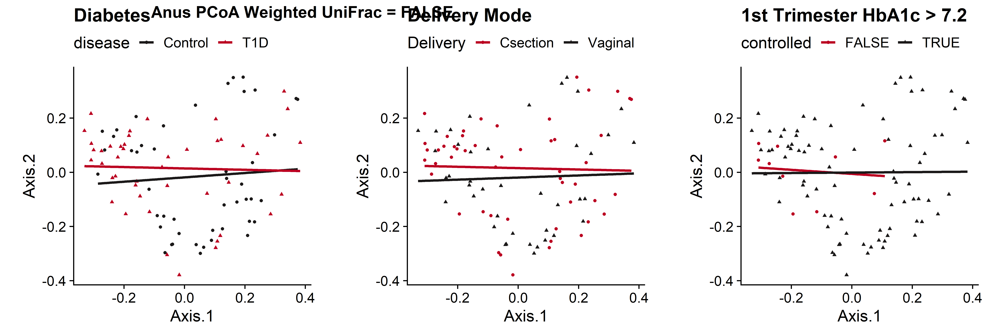
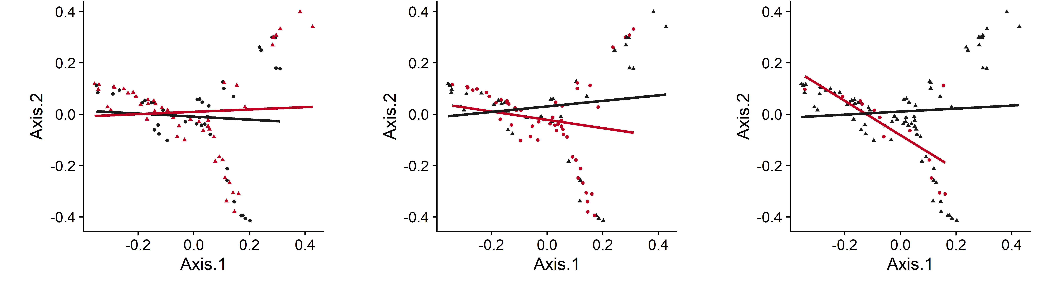
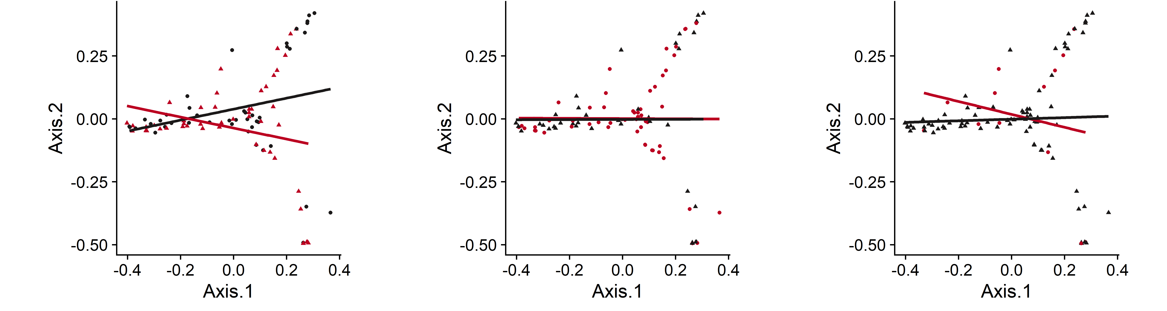
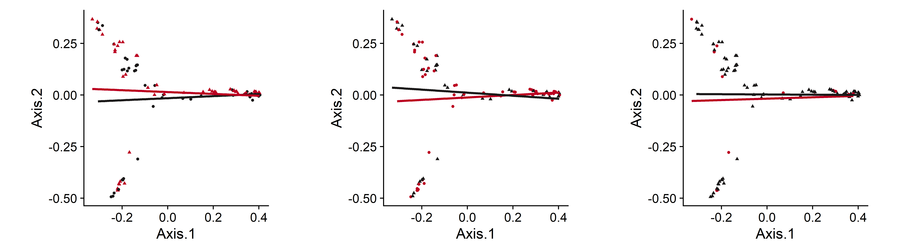
Unweighted UniFrac
Rectum
 |  | Unweighted UniFrac
Sample Type | Variable | SumOfSqs | R2 | statistic | p.value
Rectum | Type 1 Diabetes | 0.72 | 0.02 | 1.84 | 0.0034 | **
 | Delivery Mode | 0.46 | 0.01 | 1.15 | 0.1833
 | 1st Tri HbA1C | 0.59 | 0.02 | 1.49 | 0.0216 | *
Cervix | Type 1 Diabetes | 0.52 | 0.01 | 1.17 | 0.2411
 | Delivery Mode | 0.38 | 0.01 | 0.85 | 0.6525
 | 1st Tri HbA1C | 0.38 | 0.01 | 0.87 | 0.6371
Introitus | Type 1 Diabetes | 0.60 | 0.01 | 1.32 | 0.0746
 | Delivery Mode | 0.61 | 0.02 | 1.36 | 0.0611
 | 1st Tri HbA1C | 0.54 | 0.01 | 1.19 | 0.1703
Vagina | Type 1 Diabetes | 0.58 | 0.01 | 1.31 | 0.1028
 | Delivery Mode | 0.47 | 0.01 | 1.06 | 0.3484
 | 1st Tri HbA1C | 0.57 | 0.01 | 1.27 | 0.1299
PERMANOVA = 0.0034 **
PERMANOVA = 0.0216 *
Cervix
MidVaginal
Vaginal Introitus

Slide 7
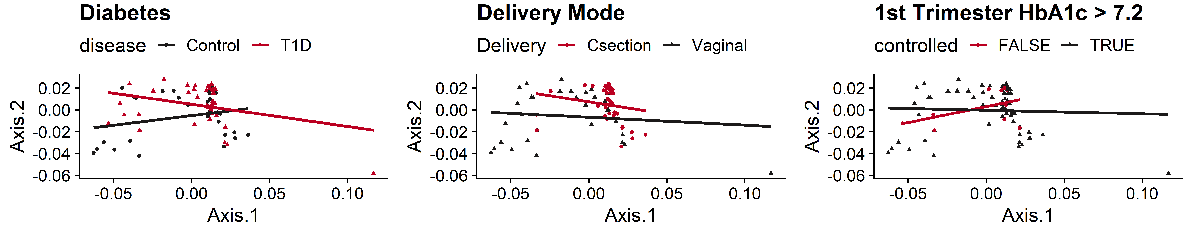
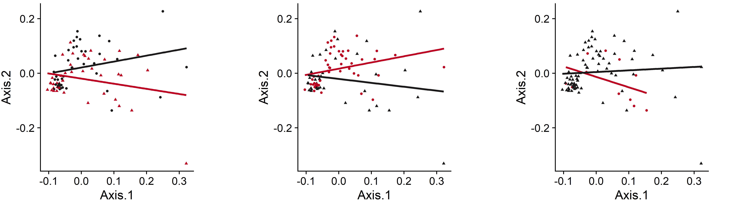
Weighted UniFrac
Stool
PERMANOVA = 0.0544 *
PERMANOVA < 0.0001 ***
Ear
PERMANOVA = 0.0508 *
PERMANOVA = 0.0076 **
 |  |  | Weighted UniFrac |  |  |  |  | Unweighted UniFrac
Host | Sample Type | Variable | SumOfSqs | R2 | statistic | p.value |  | SumOfSqs | R2 | statistic | p.value
Neonatal | Ear | Type 1 Diabetes | 0.01 | 0.02 | 1.76 | 0.0831 |  | 0.53 | 0.01 | 1.23 | 0.0954
 |  | Delivery Mode | 0.01 | 0.02 | 2.00 | 0.0508 | * | 0.74 | 0.02 | 1.72 | 0.0027 | **
 |  | 1st Tri HbA1C | 0.01 | 0.04 | 3.20 | 0.0076 | ** | 0.57 | 0.02 | 1.31 | 0.0567
 | Stool | Type 1 Diabetes | 0.00 | 0.03 | 2.27 | 0.0544 | * | 0.99 | 0.03 | 2.30 | 0.0034 | **
 |  | Delivery Mode | 0.00 | 0.10 | 8.16 | 0.0001 | *** | 2.15 | 0.07 | 5.16 | 0.0001 | ***
 |  | 1st Tri HbA1C | 0.00 | 0.01 | 0.63 | 0.6338 |  | 0.36 | 0.01 | 0.81 | 0.7286

Slide 8
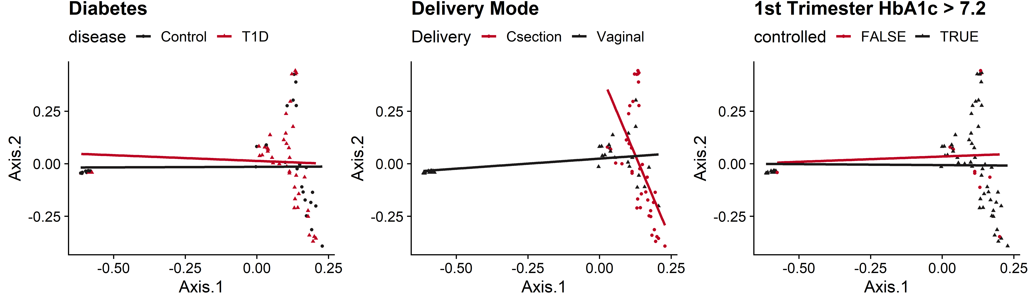
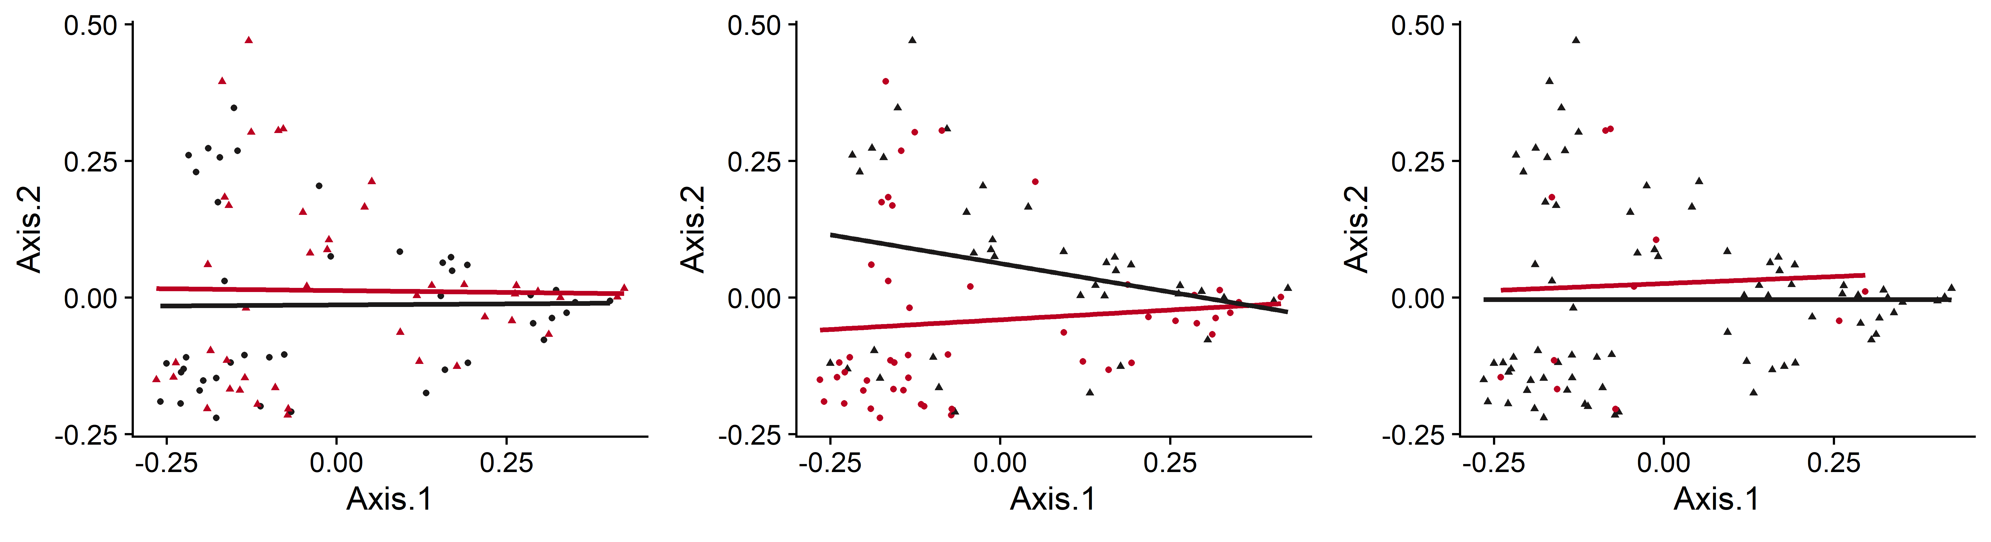
UnWeighted UniFrac
Stool
PERMANOVA = 0.0034 **
PERMANOVA < 0.0001 ***
Ear
PERMANOVA = 0.0027 **
 |  |  | Weighted UniFrac |  |  |  |  | Unweighted UniFrac
Host | Sample Type | Variable | SumOfSqs | R2 | statistic | p.value |  | SumOfSqs | R2 | statistic | p.value
Neonatal | Ear | Type 1 Diabetes | 0.01 | 0.02 | 1.76 | 0.0831 |  | 0.53 | 0.01 | 1.23 | 0.0954
 |  | Delivery Mode | 0.01 | 0.02 | 2.00 | 0.0508 | * | 0.74 | 0.02 | 1.72 | 0.0027 | **
 |  | 1st Tri HbA1C | 0.01 | 0.04 | 3.20 | 0.0076 | ** | 0.57 | 0.02 | 1.31 | 0.0567
 | Stool | Type 1 Diabetes | 0.00 | 0.03 | 2.27 | 0.0544 | * | 0.99 | 0.03 | 2.30 | 0.0034 | **
 |  | Delivery Mode | 0.00 | 0.10 | 8.16 | 0.0001 | *** | 2.15 | 0.07 | 5.16 | 0.0001 | ***
 |  | 1st Tri HbA1C | 0.00 | 0.01 | 0.63 | 0.6338 |  | 0.36 | 0.01 | 0.81 | 0.7286

Slide 9
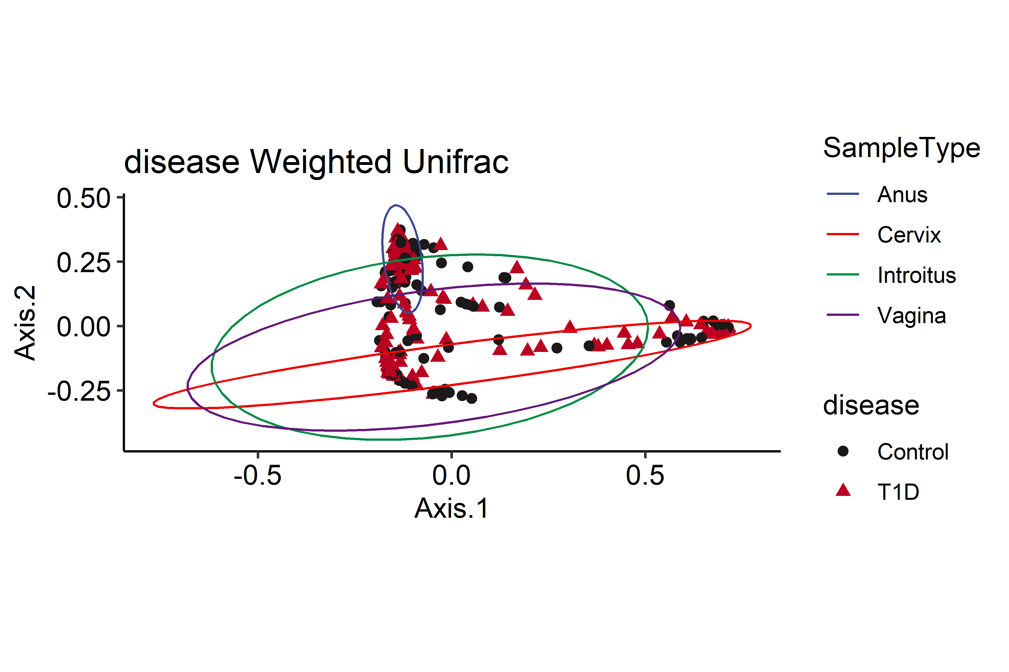
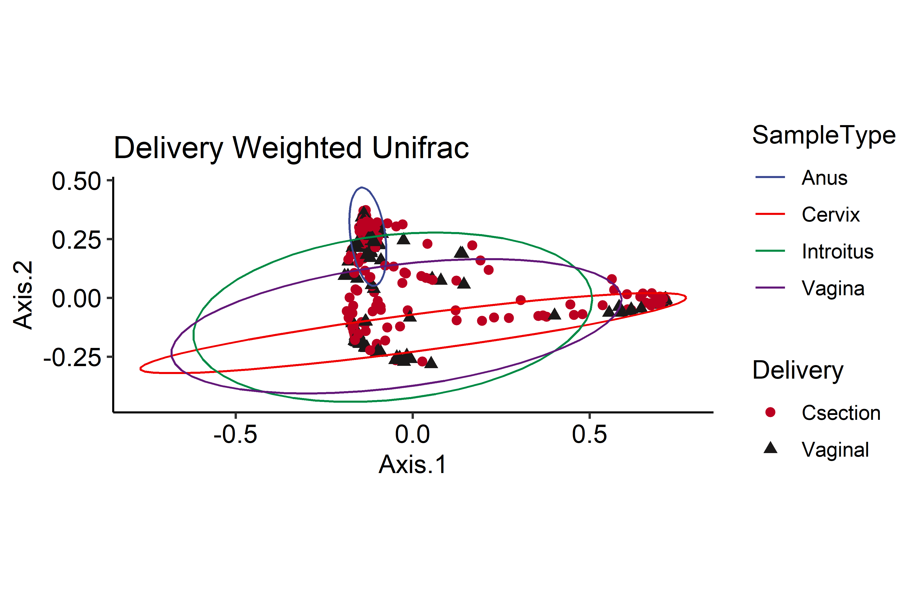
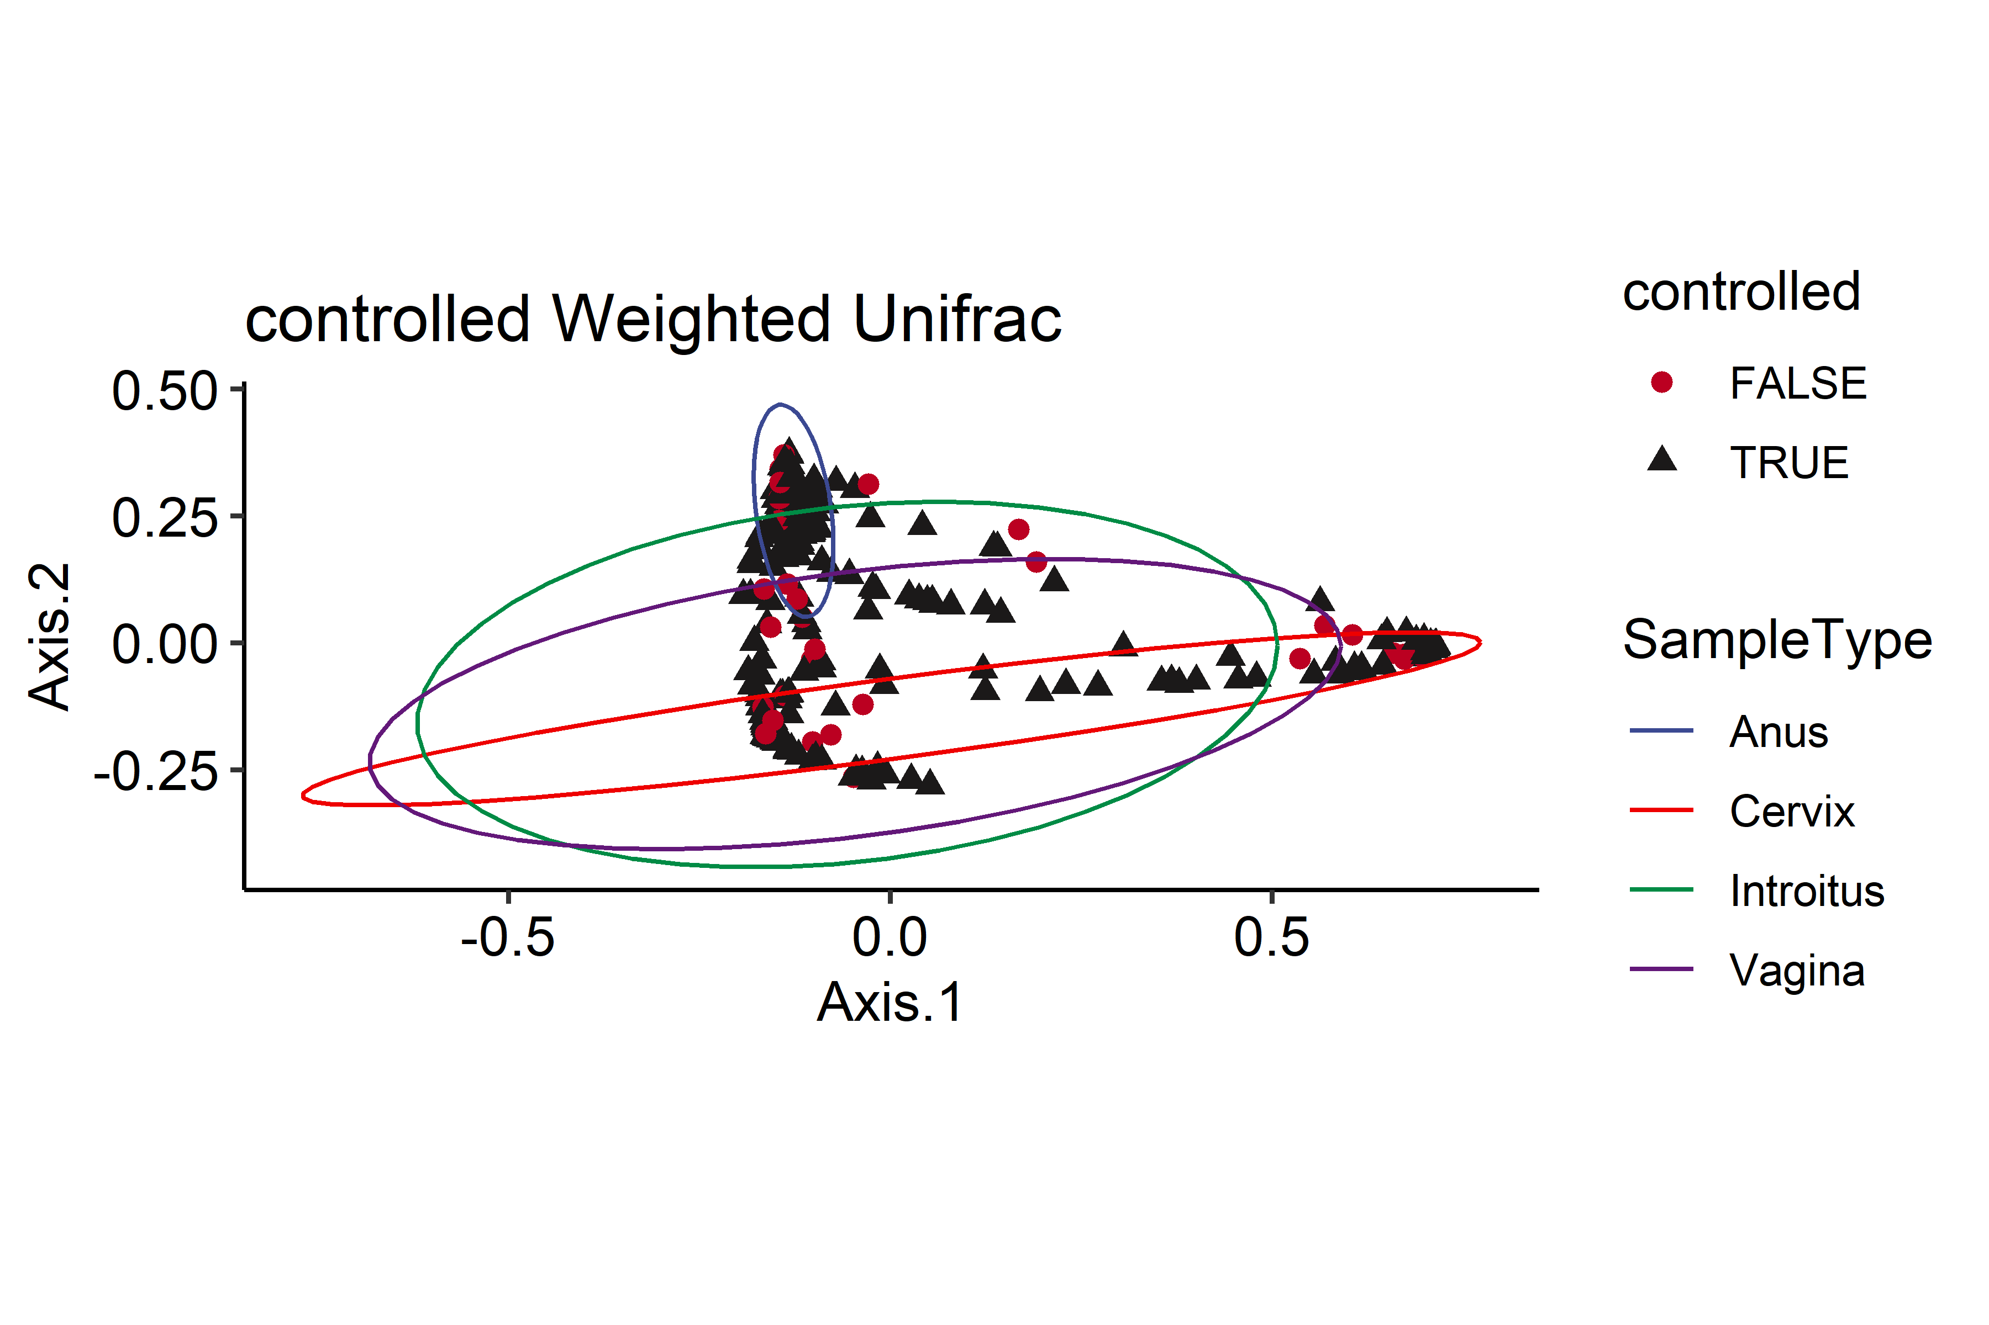
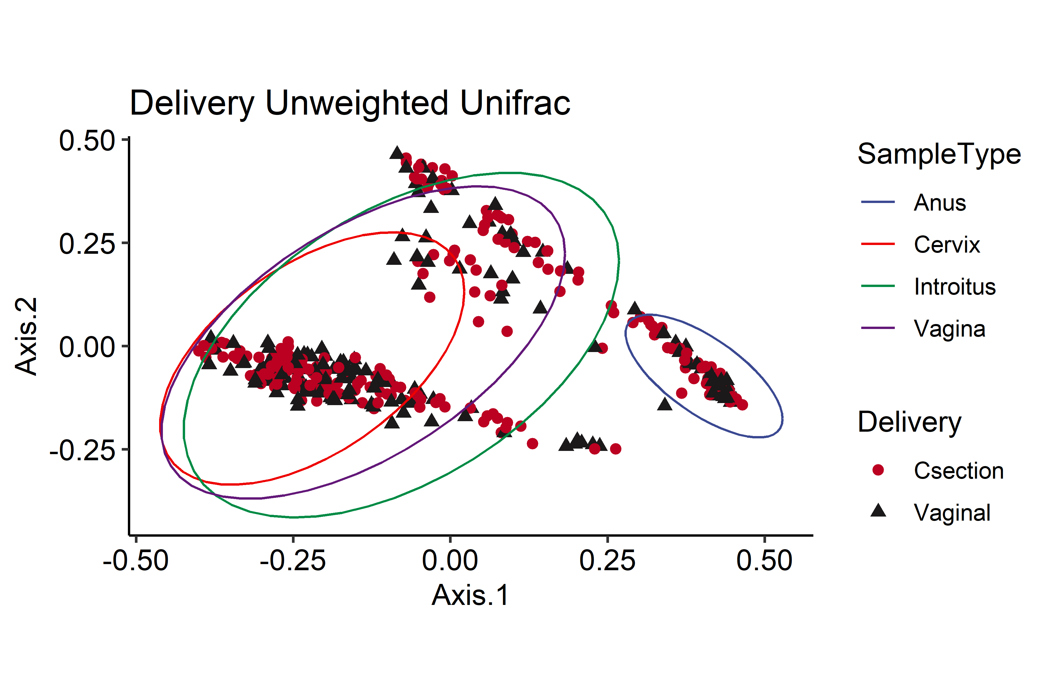
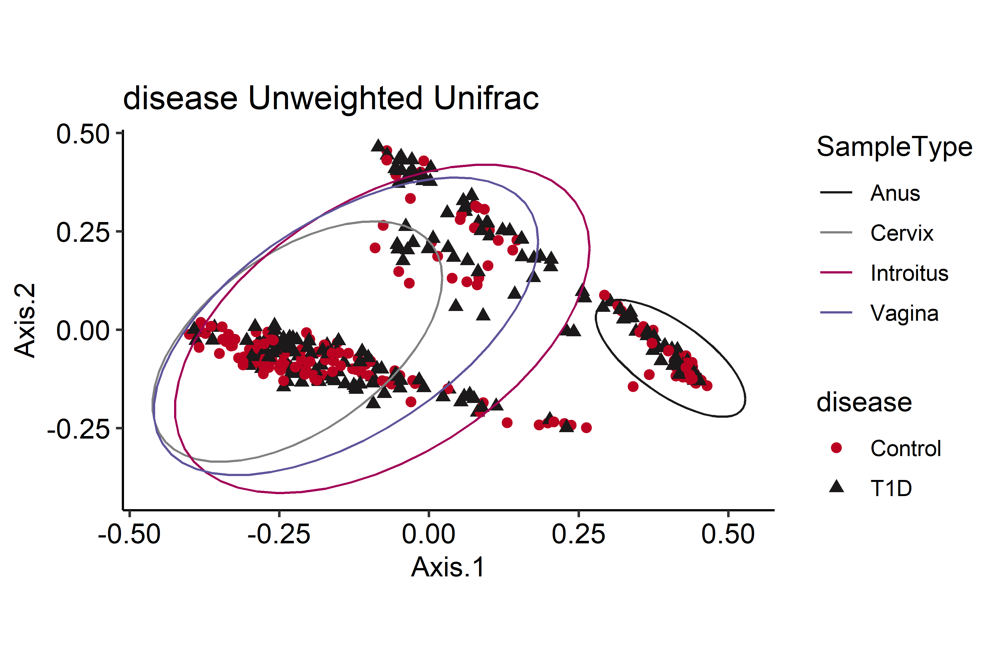
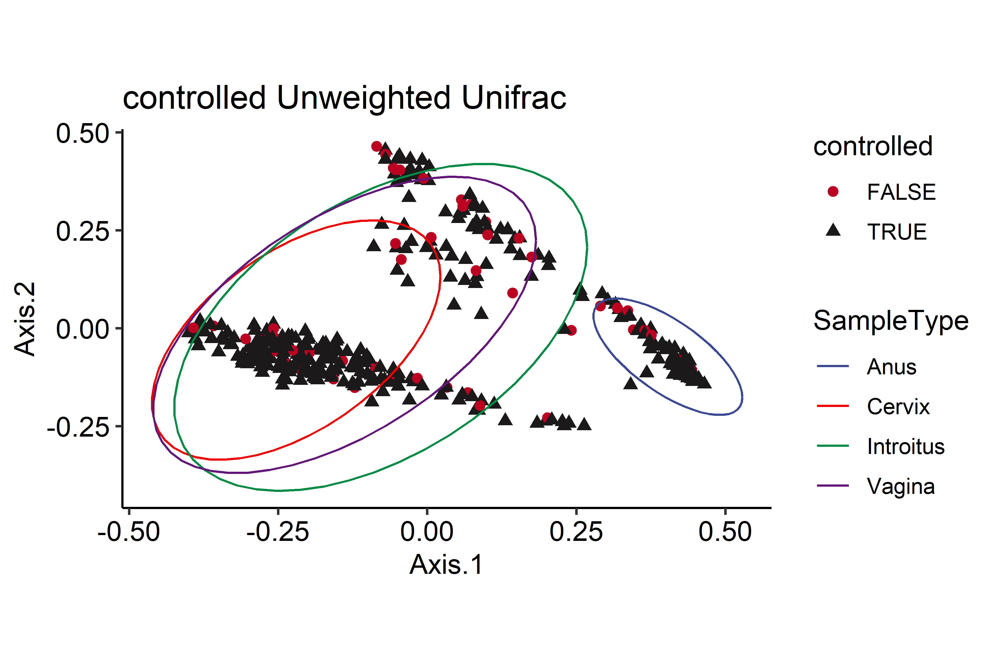
Other possible examples

Slide 10
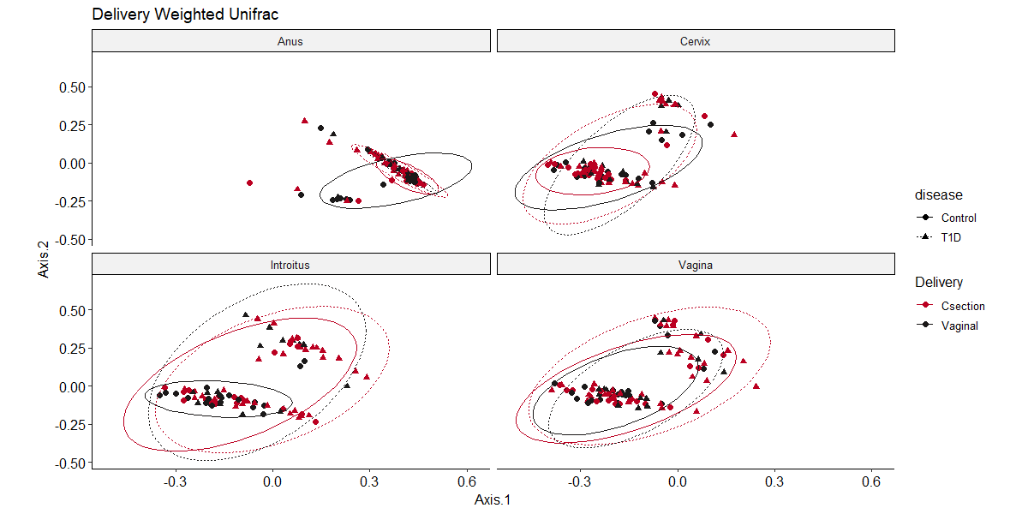
Other possible examples

Slide 11
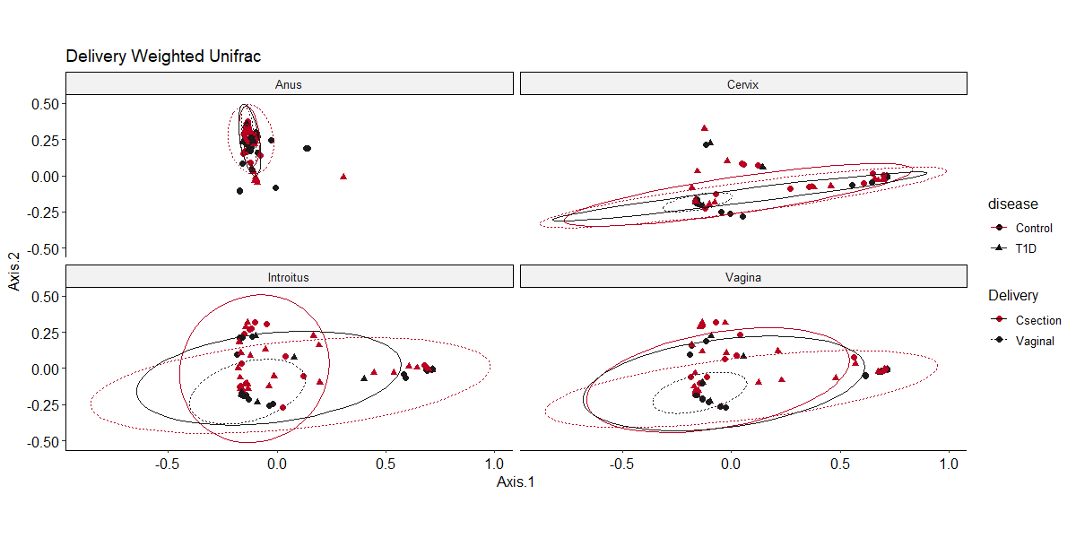
Other possible examples

